Slide 2
Technical Requirements WomCX
Architecture

Slide 3
Requirements
Authenticate.
Authorization.
Access Control.

Slide 4
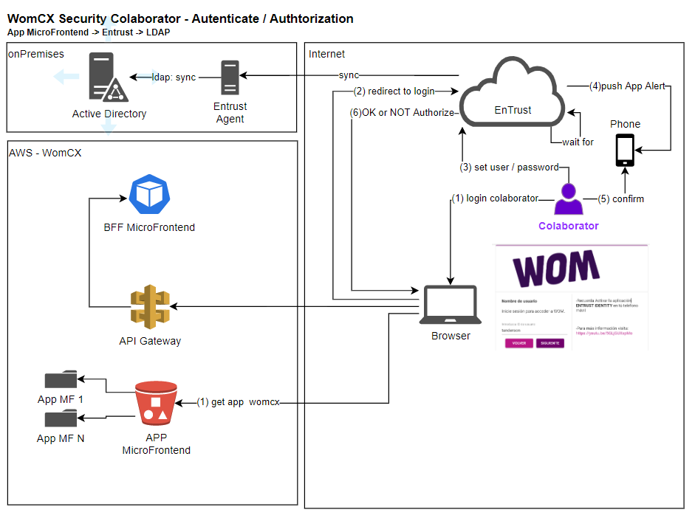
Authenticate Are you Thomas A. Anderson?

Slide 5
Authenticate Are you Thomas A. Anderson?

Slide 6
Requirements
Authenticate.
Authorization.
Profile.

Slide 7
Authorization

Slide 8
Requirements
Authenticate.
Authorization.
User Profile.

Slide 9
Access Control
Desacoplado al Microfront
Sistema de Gestión de RBAC
CORS /

